Slide 1
DATA SCIENCE PROJECT
MICRO-CREDIT PROJECT

Slide 2
CONTENTS
Introduction.
Type of Problem.
Analytical Problem Thinking.
Data Pre-Processing
Input-Output logic Relationships
Assumptions.
Model Development.
Visualizations.
Hyperparameter Tuning.
Interpretation of Results.
Conclusion.
Data Sources & Data Formats.
Hardware & Software Tools Required.
Bibliograpghy
Thank You

Slide 3
TABLE OF CONTENTS
01
02
03
PROBLEM & SOLUTION
OUR PROCESS
MODEL BUILDING
Classification Problem
Data Pre-Processing & Cleaning
Model Building & HyperParameter Tuning

Slide 4
OUR COMPANY
"Flip Robo is an artificial intelligence company. We specialize in chatbots, web scrapping, and building algorithms that help you scale up your business."

Slide 5
Introduction
A Microfinance Institution (MFI) is an organization that offers financial services to low income populations. MFS becomes very useful when targeting especially the unbanked poor families living in remote areas with not much sources of income. The Microfinance services (MFS) provided by MFI are Group Loans, Agricultural Loans, Individual Business Loans and so on.
We are working with one such client that is in Telecom Industry. They are a fixed wireless telecommunications network provider. They have launched various products and have developed its business and organization based on the budget operator model, offering better products at Lower Prices to all value conscious customers through a strategy of disruptive innovation that focuses on the subscriber.
They are collaborating with an MFI to provide micro-credit on mobile balances to be paid back in 5 days. The Consumer is believed to be defaulter if he deviates from the path of paying back the loaned amount within the time duration of 5 days. For the loan amount of 5 (in Indonesian Rupiah), payback amount should be 6 (in Indonesian Rupiah), while, for the loan amount of 10 (in Indonesian Rupiah), the payback amount should be 12 (in Indonesian Rupiah).
The sample data is provided to us from our client database. It is hereby given to you for this exercise. In order to improve the selection of customers for the credit, the client wants some predictions that could help them in further investment and improvement in selection of customers.

Slide 6
Problem Statement
We have to build a model which can be used to predict in terms of a probability for each loan transaction, whether the customer will be paying back the loaned amount within 5 days of insurance.

Slide 7
UNDERSTANDING THE PROBLEM
Classification
Regression
When our target variable refers to a predictive modeling problem where a class label is predicted for a given example of input data.
When our target variable is continuous and it is not divided into any kind of class then it falls under the above mentioned.
From the Dataset we can clearly understand that it is an Classification Problem.

Slide 8
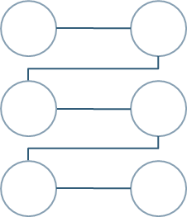
OUR SOLUTIONS
IDENTIFY
CLEAN
VISUALIZE
BUILD MODEL
Identify the type of Probelm
Cleaning the Dataset.
Visualizing the relations between the independent variables.
Select Best features through F1 Score and build the model.

Slide 9
Analytical Problem Framing
As from the Problem statement we can understand that this Dataset needs Classification for Model Building.
We will be using some classifier algorithms to try and find the Best Model for our Dataset.
As from the Dataset we have seen that it is highly Imbalanced we will be using SMOTE to make it a balanced Dataset.

Slide 10
Data Sources & Formats
The Dataset is in a .csv (comma separated value).
The general information about the dataset is given in a documentation format.
Information about the dependent and independent variables are given in an Excel Format.

Slide 11
Data Pre-processing
Data pre-processing is a data mining technique that involves transforming raw data into an understandable format. Real-world data is often incomplete, inconsistent, lacking in certain behaviours or trends, and is likely to contain many errors.
Data pre-processing is a proven method of resolving such issues. Data pre-processing prepares raw data for further processing. Data pre-processing is used in database-driven applications such as customer relationship management and rule-based applications (like neural networks).
In Machine Learning (ML) processes, data pre-processing is critical to encode the dataset in a form that could be interpreted and parsed by the algorithm.

Slide 12
So now we have established what is Data pre-processing, I will let know all the steps I took to clean the Data before proceeding:
- Firstly I checked for Null Values, there were none so we have not done anything with that.
- Secondly I checked for any Nan values in the dataset which I found, so I filled all the Nan values with zero rather than removing it.
- Thirdly I found outliers and skewness in the Dataset which I dealt with by using median of the columns and replacing it with respective medians.
- I also found some ‘-‘sign in the dataset. Which I removed with the help of replace statement.

Slide 13
Real World/Business objectives & Constraints
No low-Latency requirement
Interpretability is important
Probability of a Data-Point belonging to each class is needed.

Slide 14
Assumptions
As from the Problem statement which states that we have to build a model which will predict default for a person. Since the target variable is not continuous we can readily presume that it is a Classification Problem for which we will be using Classification algorithms to build our model from the dataset given.
Secondly as we know Data is very expensive I tried those methods for Data cleaning which doesn’t require removal of bulk of Data.
Like for example I did not use IQR method for Outliers as it would have erased huge amounts of Data. Instead I used Median method for Outlier treatment.
Thirdly we can clearly see that the Dataset is highly Imbalanced which may create a biased model as our computer will pass all the minority class as noise. So that’s why we will be using SMOTE to balance out the entire dataset.
Lastly I will be using RandomSearch CV for hyper parameter tuning as it uses least amount of memory and processing power to run the algorithms as compared to that of GridSearch CV.

Slide 15
Identification of Possible Problem Solving approaches
There are no null values in the dataset.
There may be some customers with no loan history.
The dataset is imbalanced. Label ‘1’ has approximately 87.5% records, while, label ‘0’ has approximately 12.5% records.
For some features, there may be values which might not be realistic.
I also came across outliers in some features

Slide 16
Visualization
We will be using Libraries such as Seaborn, matplotlib, plotly. At first we will be importing the libraries so that we can use visualizations for our Dataset.
We will perform Univariate analysis, Bivariate Analysis and Multivariate Analysis to get insight of the Micro Credit Project Dataset.
Outliers and skewness is also being detected by visualization with the help of boxplots.

Slide 17
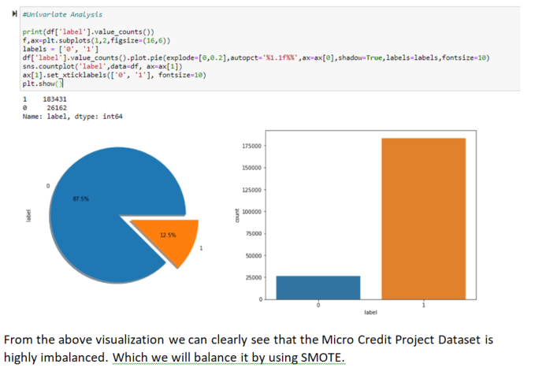
Univariate Analysis of Label

Slide 18
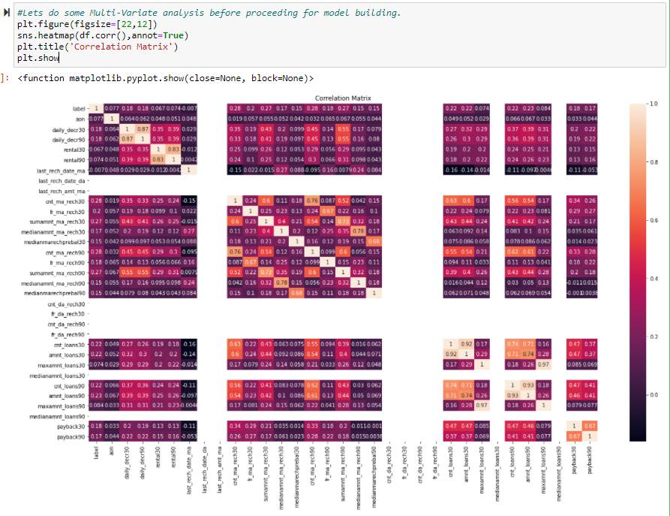
Multivariate Analysis for Correlation

Slide 19
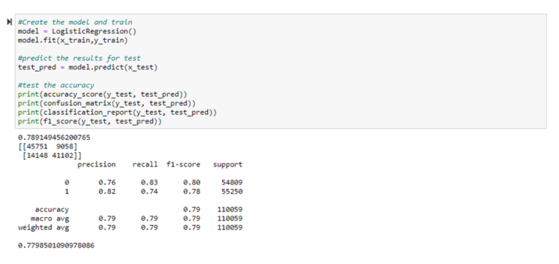
Model Building
So for the project Micro Credit I will be using these following algorithms which I choose by keeping in mind the time taken to iterate and what is better for this Dataset:
So the first Model which I am going to use is Logistic Regression.

Slide 20
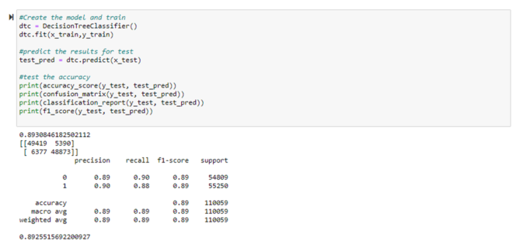
The second Model which I am going to use is Decision Tree Classifier.

Slide 21
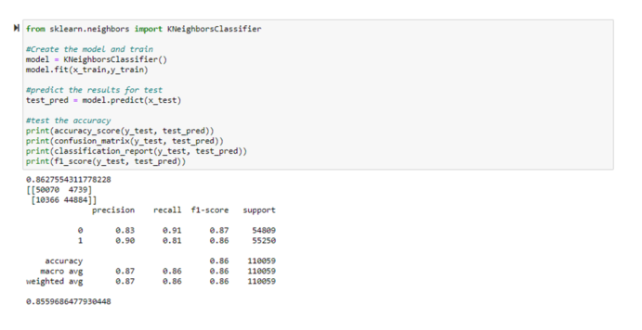
The Third Model which I am going to use is KNeighbors Classifier.

Slide 22
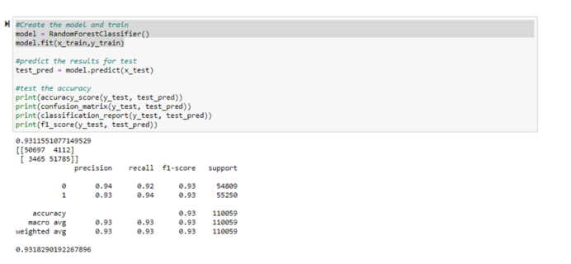
The Fourth Model which I am going to use is Random Forest Classifier.

Slide 23
Best Model
Random Forest Classifier had the best fit with a F1 score of about 0.93.
So we will be using this classifier for our RandomSearch CV hyper parameter tuning.

Slide 24
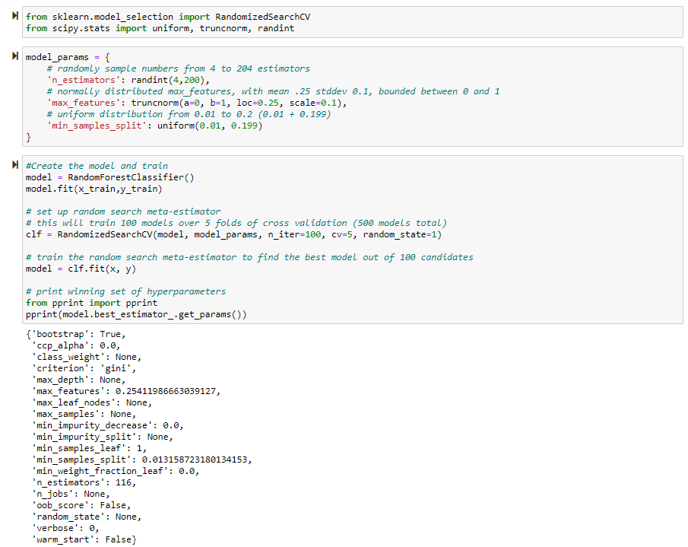
RandomSearch CV

Slide 25
Conclusion
From this project I draw these following conclusions:
I found that Smote Is one of the best technique for highly imbalanced datasets.
There were many zero values in the column, I have to use if else statements in my code to remove skewness.
When using Machine learning algorithms I found that SVC took a lot of time as compared to other methods I used for Model building.
Random Forest Classifier Had the highest F1 and accuracy score in all of the models I used to predict.

Slide 26
RESOURCES
Hardware Tools Used:
Lenovo Ideapad Gaming 3, 16GB of RAM.
Inbuilt AMD Radeon graphics and External Nvidia 1650 ti graphics card.
Ryzen 5 processor
512 GB SSD
Software Tools Used
Anaconda for calling JN.
Jupyter Notebook for Code handling and Visualization.
Python Shell for installing some libraries.
Excel for calling .CSV(comma separated values)
Microsoft Word for documentation.
Word to pdf Converter Online.(WBA)
Microsoft Power Point Presentation

Slide 27
THANKS

